Slide 1


Sales Forecast and Churn Prediction for the International Health Insurance Company
Course: Data Science Continuous Mar23
Jonathan Leipold | Christian Hirning | Rumiya Al-Meri

Slide 2
Introduction, ……

Slide 4
Sales Forecast
First Sub-Project

Slide 7
Churn Prediction
Second Sub-Project

Slide 8
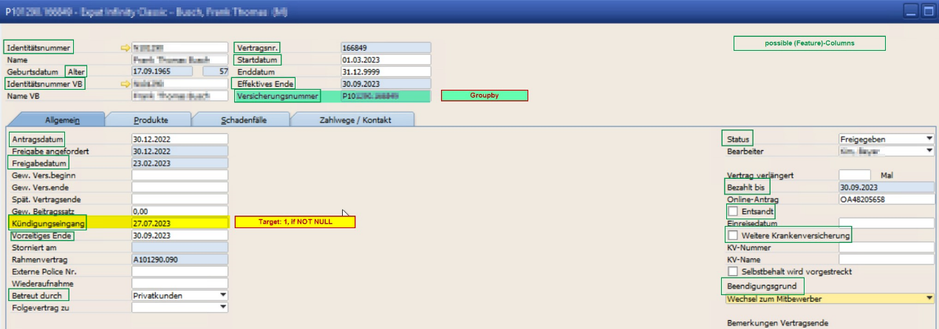
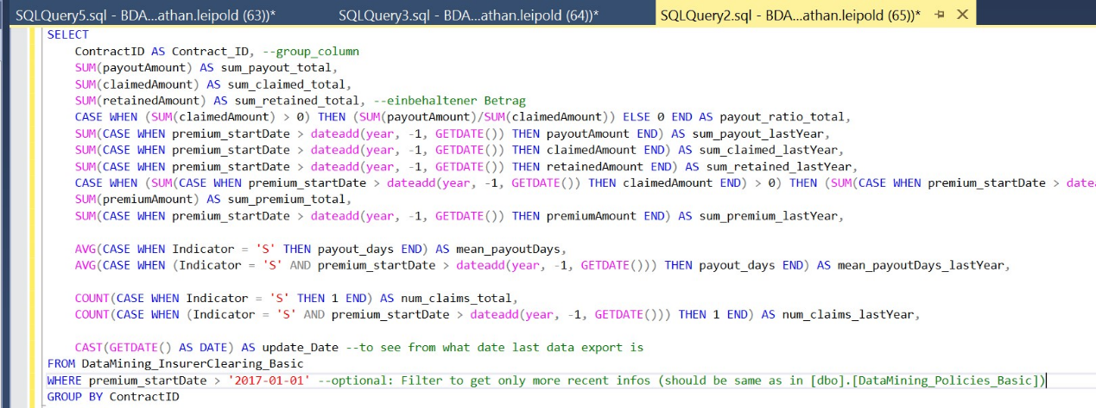
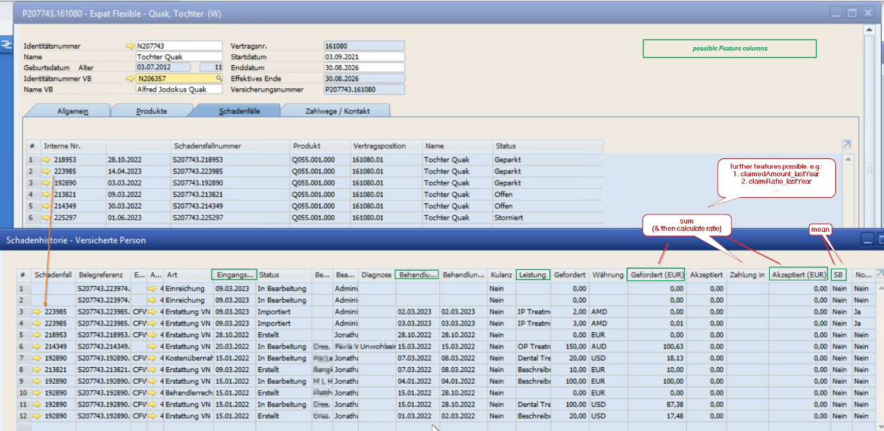
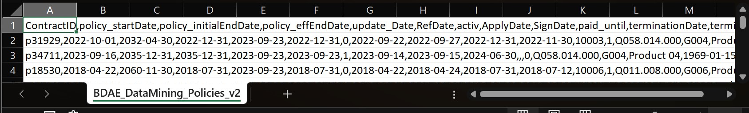
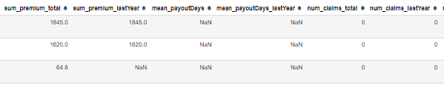
Churn Prediction – Data Collection
Notes:
Data collection process: SAP → SQL → CSV → JupyterNotebook

Slide 9
Churn Prediction – Column descriptions
Column | Datatype | Description
ContractID | string | pseudonymised unique ContractID (index / primary Key)
policy_startDate | date | start Date of contract (Filtered to >= 01.01.2017)
policy_initialEndDate | date | initial end Date at beginning of contract
policy_effEndDate | date | effective end Date of contract (due to earlier cancellation/…)
update_Date | date | date of last data extraction from SQL database
activ | boolean | if contract is still activ or already ended
ApplyDate | date | date of contact application by the customer
SignDate | date | date of contract signing by the customer
paid_until | date | date until premium is paid for this contract
terminationDate | date | date of contract termination by the customer
terminationReason | string / categorical | reason for contract termination
terminated | boolean | if contract got terminated by the customer (target variable)
product_code | string | code of insurance product
MainProductCode | string | code of main insurance product group
MainProductName | string | name of main insurance product group (pseudonymised)
insured_birthDate | date | birthday of insured person
insured_Gender | string | gender of insured person
insured_nationality | string | nationality of insured person
holder_country | string | country of contract holder
Expatriate | boolean | if insured person is expatriate
additional_insurance | boolean | if insured person has an additional insurance
Column | Datatype | Description
RefDate | date | reference date to compare last year of active (-> update_Date) and ended contracts (-> effEndDate)
num_claims_total | integer | total number of claims (invoices) handed in by the customer
sum_claimed_total | float | total amount of money claimed by the customer
sum_payout_total | float | total amount of money paid out to the customer
sum_retained_total | float | part of claimed money that did not get paid out
payout_ratio_total | float | total ratio of paid out vs. claimed money (payout/claimed)
mean_payoutDays | integer | mean waiting time in days between claim and payout of money
num_claims_lastYear | integer | same as above, but for last year before update_Date
sum_claimed_lastYear | float
sum_payout_lastYear | float
sum_retained_lastYear | float
payout_ratio_lastYear | float
sum_premium_total | float
sum_premium_lastYear | float
mean_payoutDays_lastYear | integer
num_claims_lastActivYear | integer | same as above, but for last year before RefDate (activ contracts --> last year / ended contracts --> last year before effEnd)
mean_payoutDays_lastActivYear | integer
sum_payout_lastActivYear | float
sum_claimed_lastActivYear | float
sum_retained_lastActivYear | float
sum_premium_lastActivYear | float
Notes:
Important columns:
Terminated
terminationReasons
Policy_start- & effEndDate
Sums of premium-, claim- & payout
+ Product information in separate df (less important because no big impact in modelling)

Slide 10
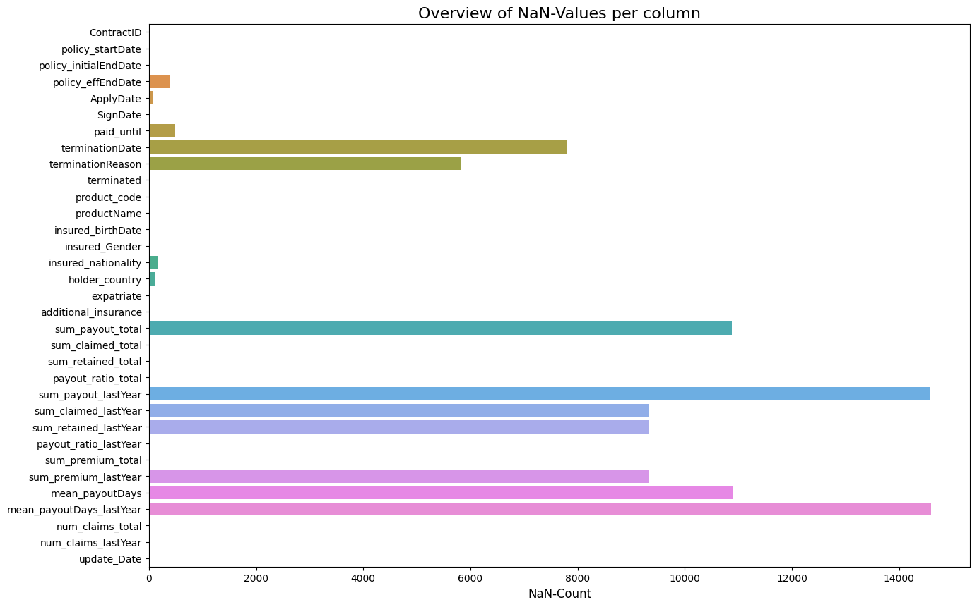
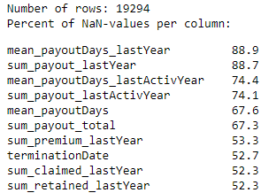
Churn Prediction – Challenge missing values
Notes:
Took a lot of time to explain & prepare all columns for modelling.
Besides missing values:
a lot of outliers
highly correlated columns
(not necessary → HIDE)

Slide 11
Churn Prediction – Confusion Matrix
 |  | PREDICTED
 |  | Contract Terminated (1) | Contract Non-terminated (0)
TRUE |  | TRUE POSITIVE (TP) | FALSE NEGATIVE (FN)
 | Contract Terminated (1) | Model correctly predicts that the contract is terminated by the customer. | The model predicts that the contract is still active or has ended naturally but it is terminated.
 |  | FALSE POSITIVE (FP) | TRUE NEGATIVE (TN)
 | Contract Non-terminated (0) | The model predicts that the contract has been cancelled, but it is still active or has ended naturally. | The model correctly predicts that the contract is still active or has ended naturally.
Notes:
Focus on big TP & small FP (False Negative) error → try to detect as many terminated contracts → keep track on precision too → F1 Score
→ Mainly focus on score of test set, containing more recent contracts

Slide 12
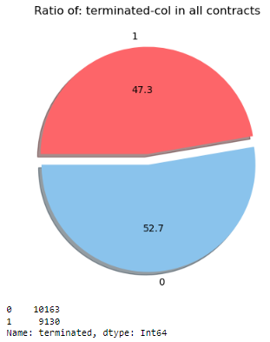
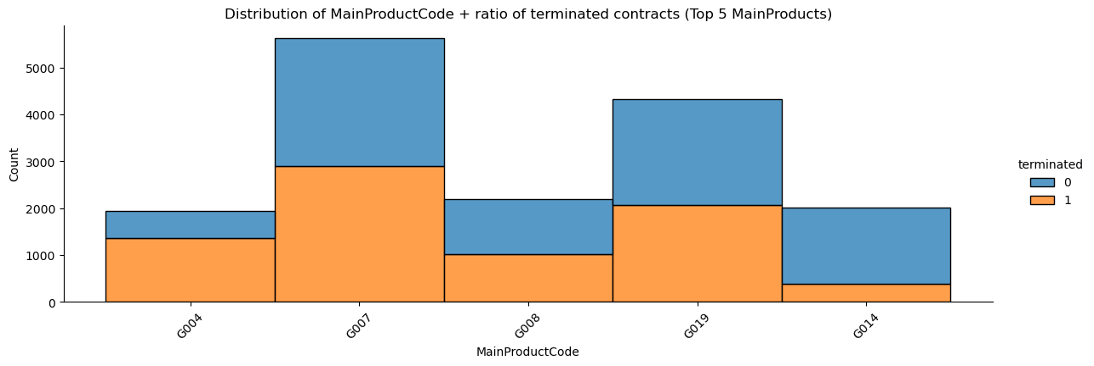
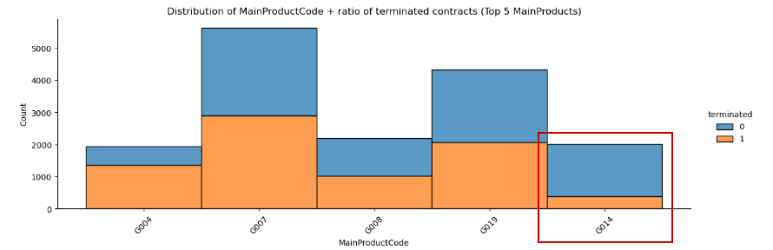
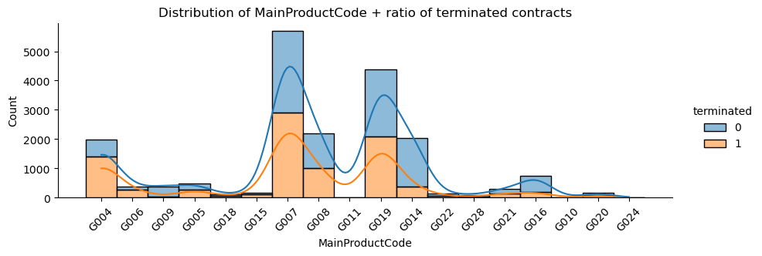
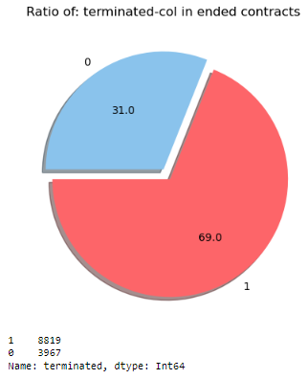
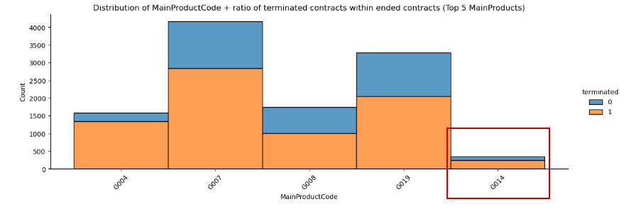
Churn Prediction – Target variable
Notes:
termination is not a rare thing. ~1/2 of all contracts are terminated → several reasons. E.g. different types of product:
G004: Business → terminated, e.g. when employee cancelled
G014: Infinity → lifelong → if ended, it’s terminated most of the times (overall 19% terminations vs. 70% within ended contracts)
effEnd is a major impact
→ Looking only at ended contracts → it’s even ~2/3 terminations

Slide 13
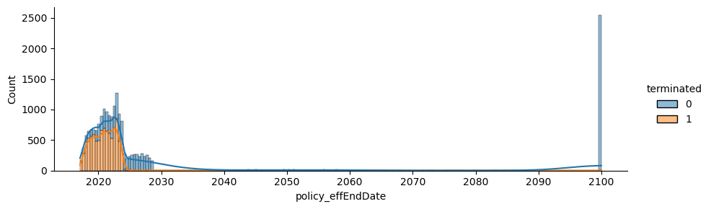
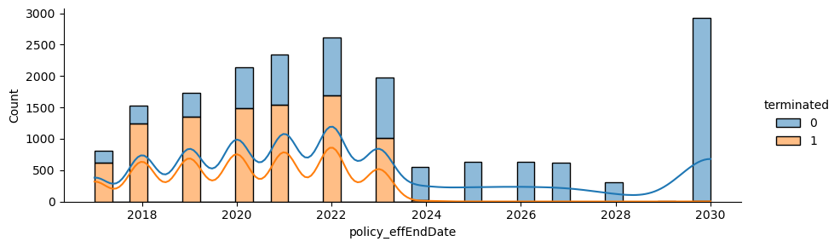
Churn Prediction – Target variable & effEnd
Notes:
Termination rate goes → 0 for active contracts (effEndDate > now)
effEndDate can be cuted in preprocessing function
More specific look on termination with terminationReasons

Slide 14
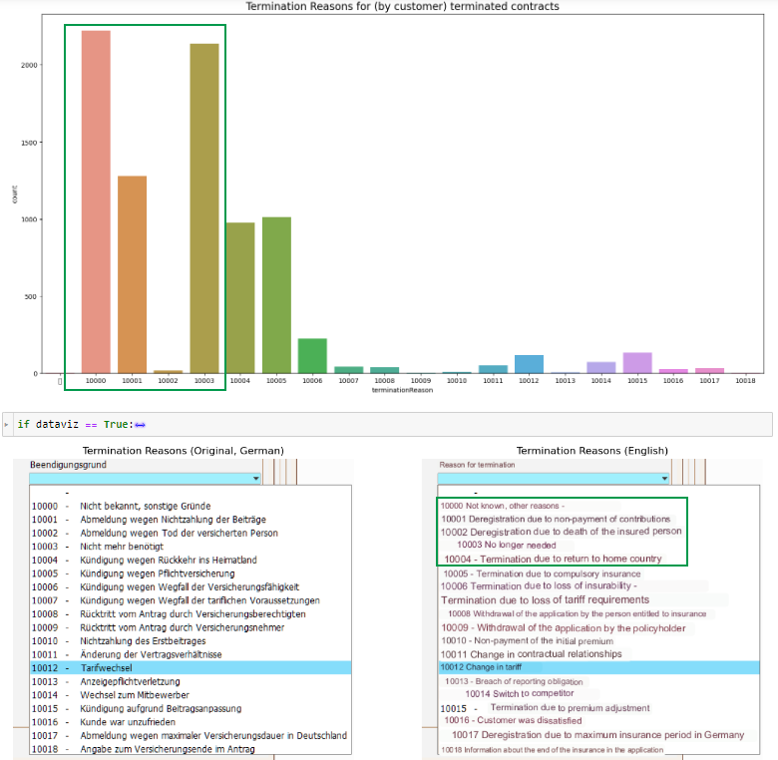

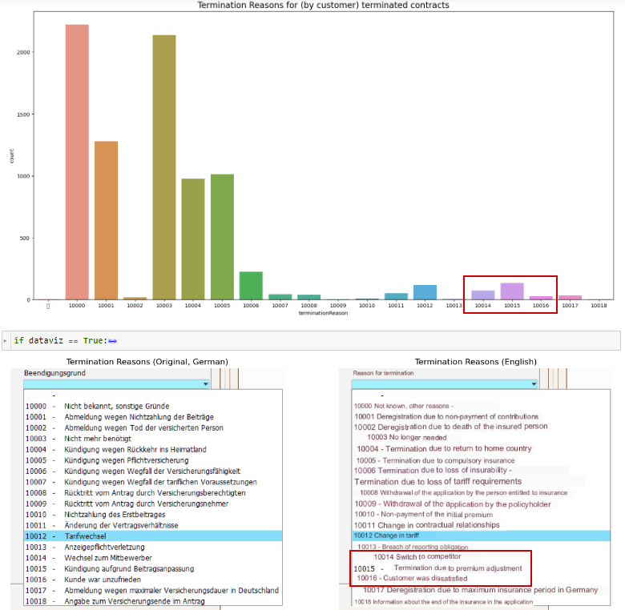
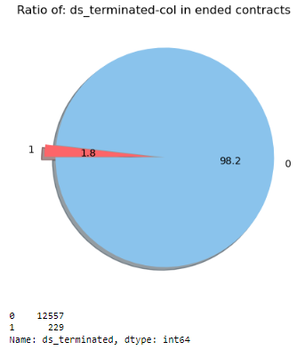
Churn Prediction – Alternative target
Notes:
Looking at reasons of termination:
Mostly unspecific: Not know, No longer needed, Non-Payment (Cancelled by company by end of next month → next month not paid → terminated)
Looking only at reasons that show dissatisfaction → imbalanced data

Slide 15
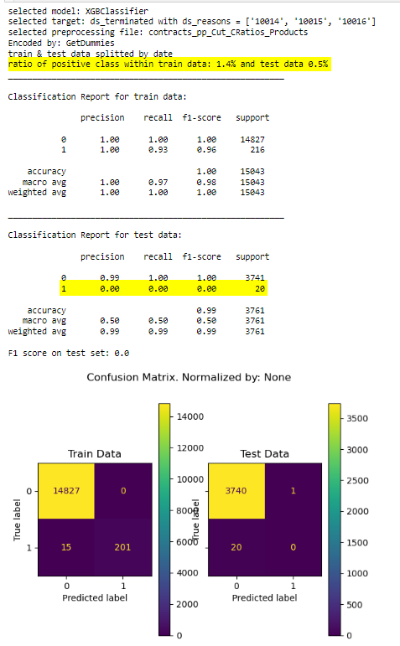
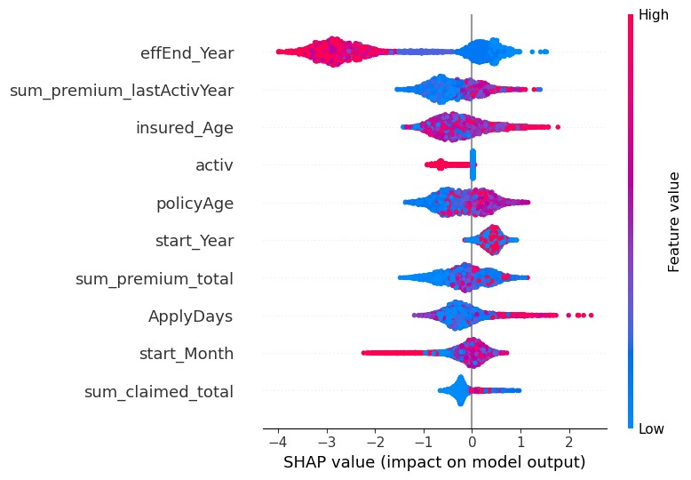
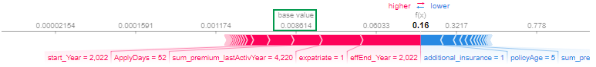
Churn Prediction – First results ds_terminated
Notes:
Left: First results on alternative target → F1_test = 0
Right: SHAP explanations: Base value < 0,01 → very low probability of class 1

Slide 16
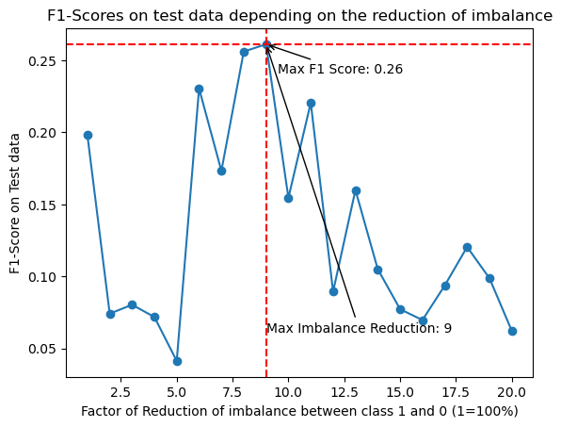
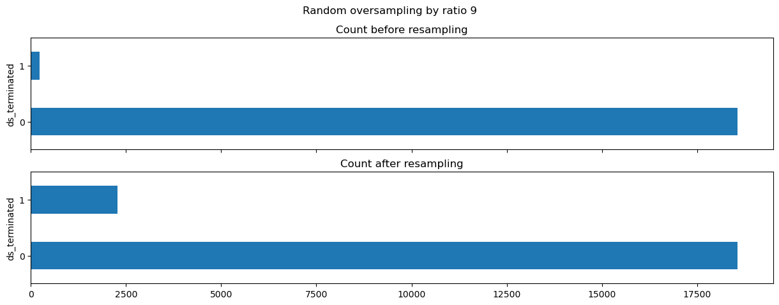
Churn Prediction – Resampling
Notes:
Resampling improved the score from 0 to ~0.3 on the test set
GridSearch von XGB further improved it to ~0.5
(But: test data got resampled to → higher chance as well for random choise)

Slide 17
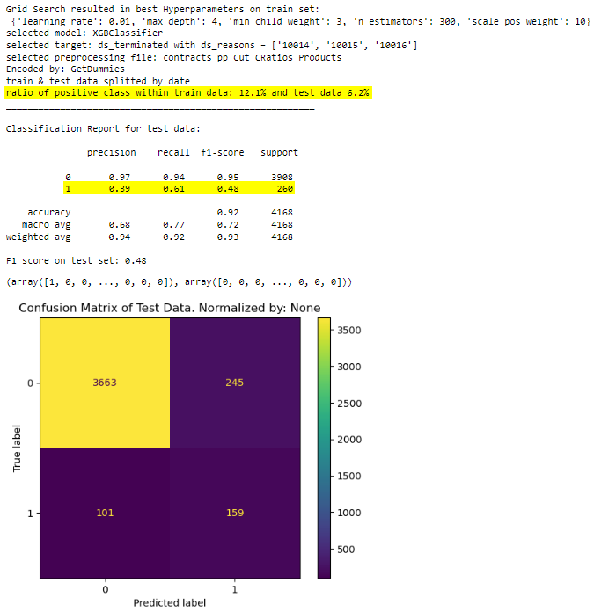
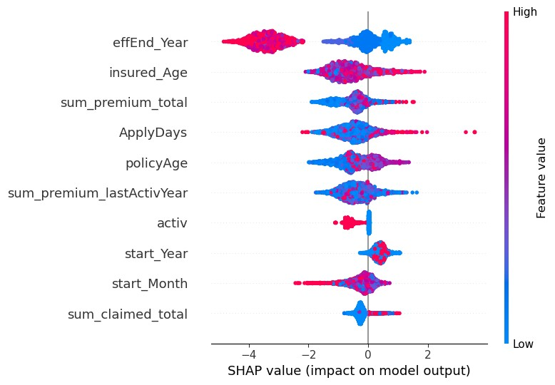
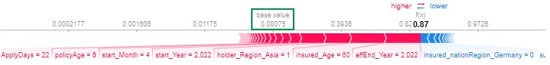
Churn Prediction – Results after resampling
Notes:
Left: Results after Resampling & GridSearch → F1_Test ~0.5
Right: New SHAP data → Higher base value & greater impact of feature values
(apparently greater termination probability created artificially)

Slide 18
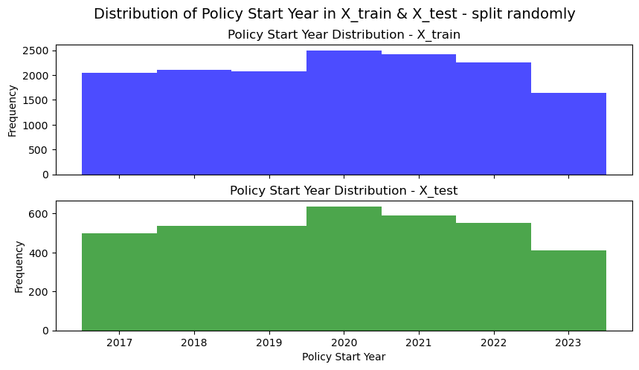
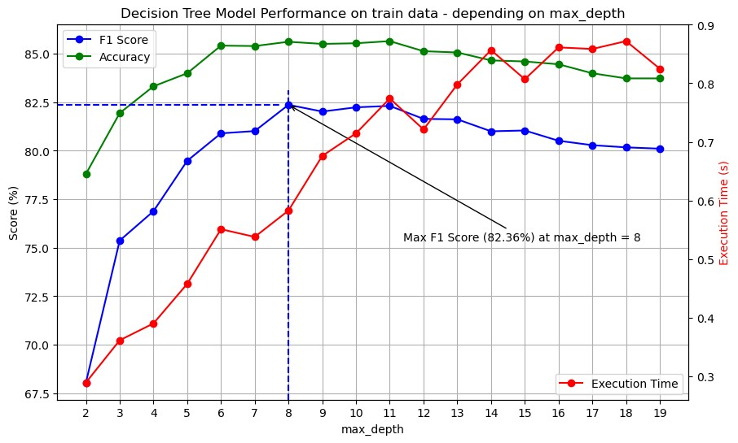
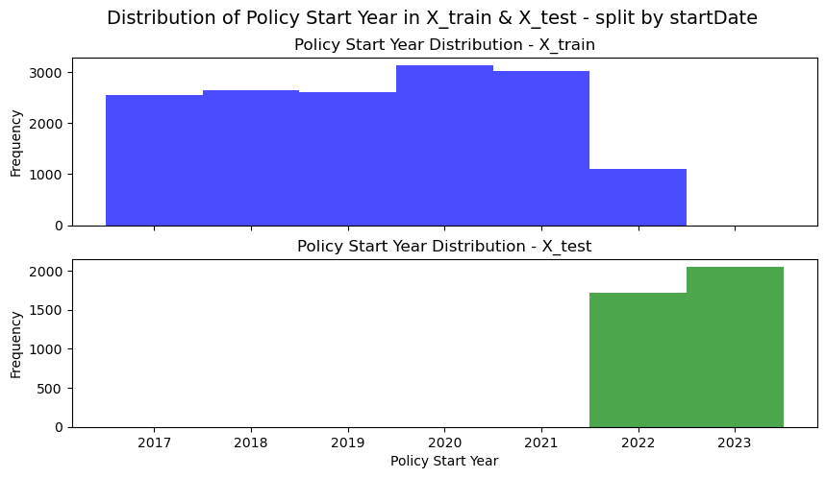
Churn Prediction – Random Test data
Notes:
Left: Score was OK for Decision Tree on random train-/test-splitted data.
Right: New train-test/split by startDate

Slide 19
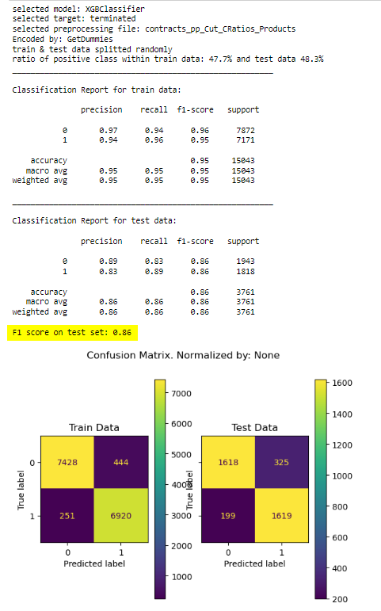
Churn Prediction – Random Test data
Notes:
Left: Score was OK for Decision Tree on random train-/test-splitted data.
Right: New train-test/split by startDate

Slide 20
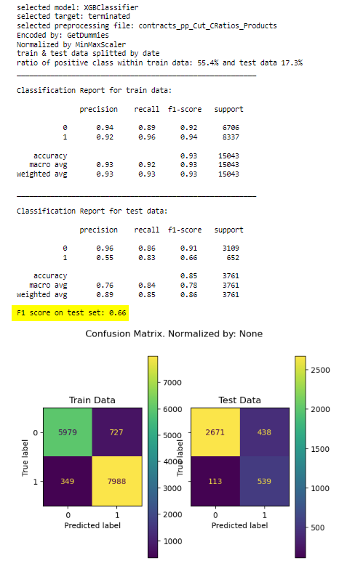
Churn Prediction – Time-related Test data
Notes:
Left: Standardised evalauation of all models
Right: Comparison
Similar results on test data (most recent contracts)
XGB & DT fastest & XGB works best with SHAP

Slide 21
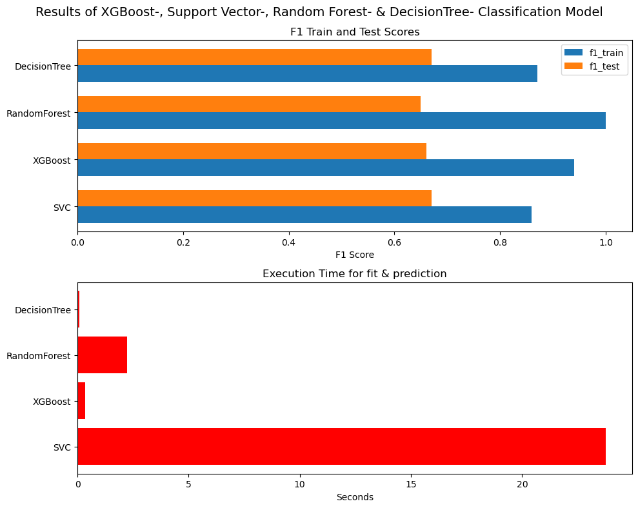
Churn Prediction – Model comparison
Notes:
Left: Standardised evalauation of all models
Right: Comparison
Similar results on test data (most recent contracts)
XGB & DT fastest & XGB works best with SHAP

Slide 22
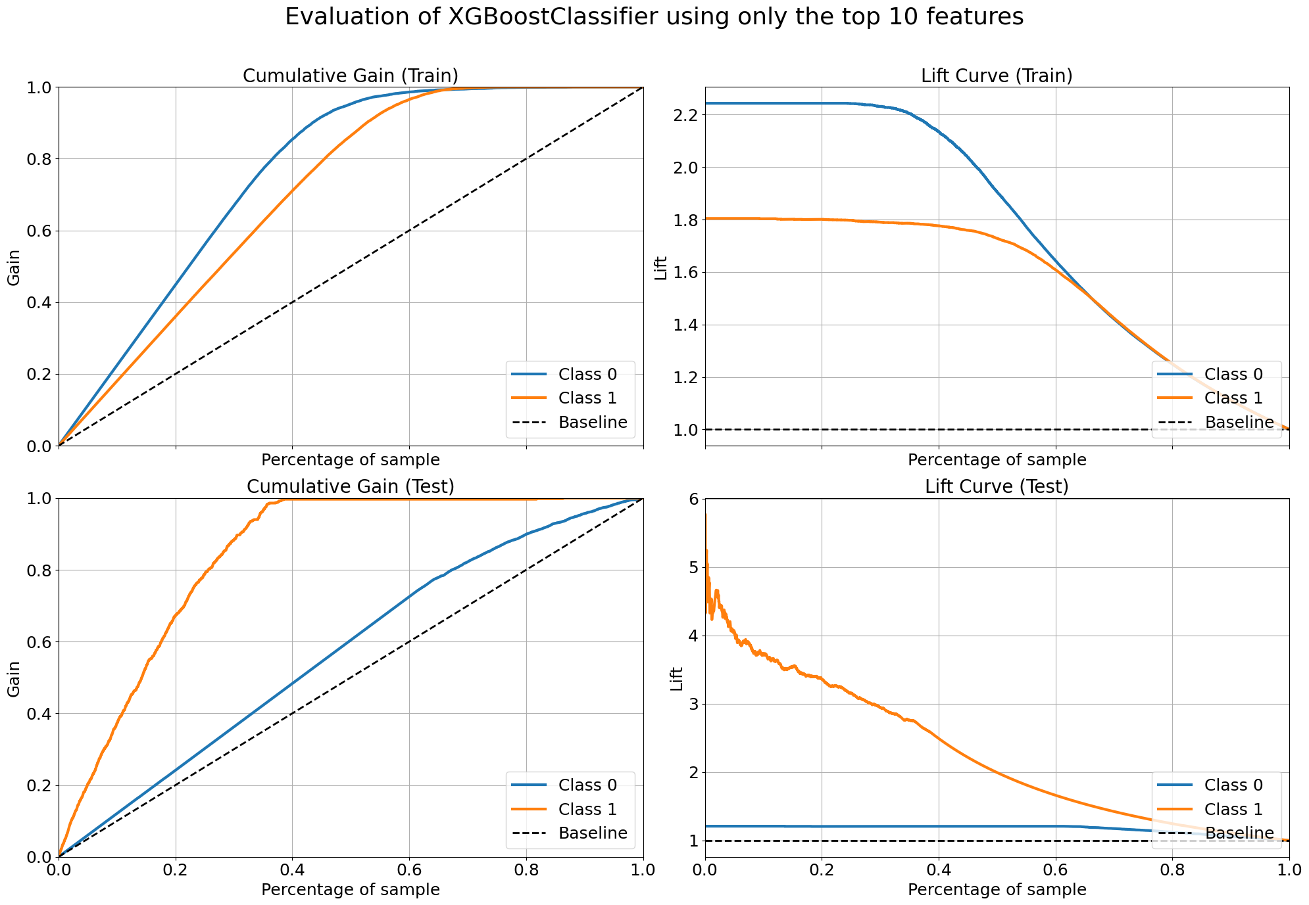
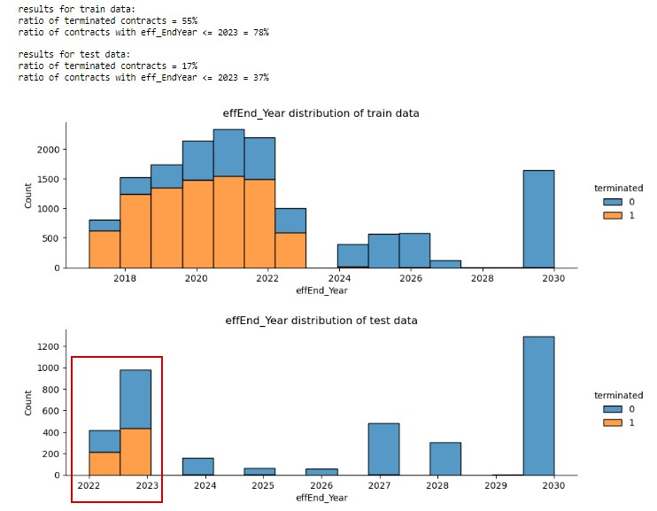
Churn Prediction – Termination Probabilities
Notes:
Left: CumGain very good on Class 1 in TestData
Right: Reason = 37% of earliest effEnd includes 17% terminated contracts

Slide 23
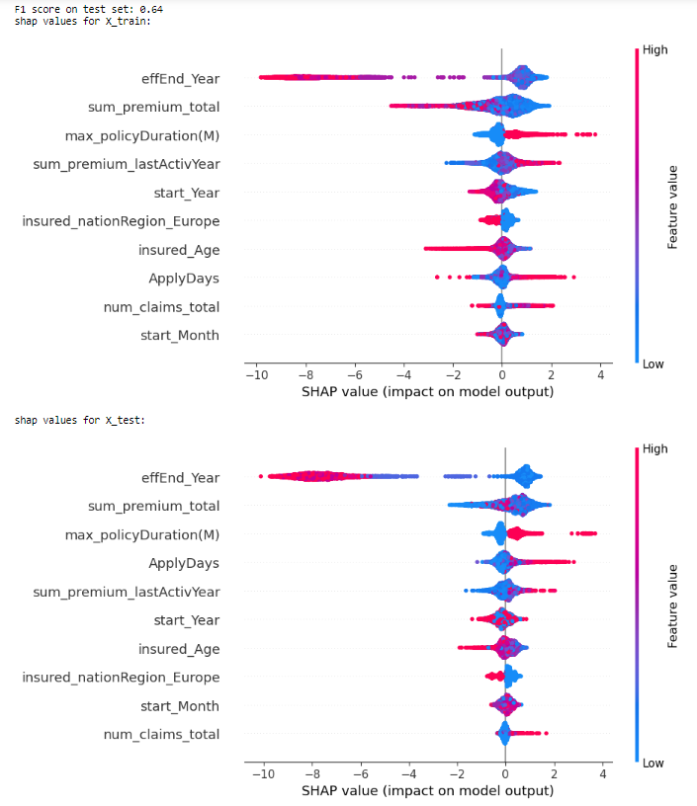
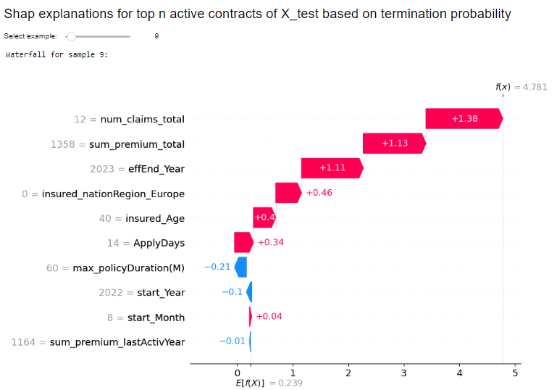
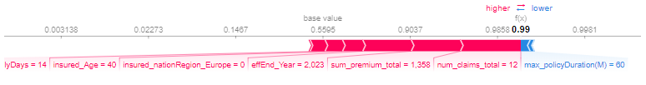
Churn Prediction – SHAP Interpretations
Notes:
For better overview only top 10 features taken
Left: Globally main features → effEnd dominant (low effEnd → terminated)
- max_policyDuration → if infinit: set to highest policy age in df (81) → infinit contracts get terminated more often → positive impact
Right: individual example of ACTIV contracts with highest proba being predicted as “terminated”:
In example: effEnd_Year = 2023 → could be ended already → additionally high number of claimsb

Slide 24
Conclusion
Results
Challenges
Sales Forecast:
Churn Prediction:
Solid results, XGBClassifier most suitable for interpretation
Too much focus on effective end
Limited business relevant success
project management
real word data
preprocessing & interpretation
human made decisions
Notes:
JL: Don’t know if it’s necessary, but 1 common conclusion could be nice.

